Slide 1
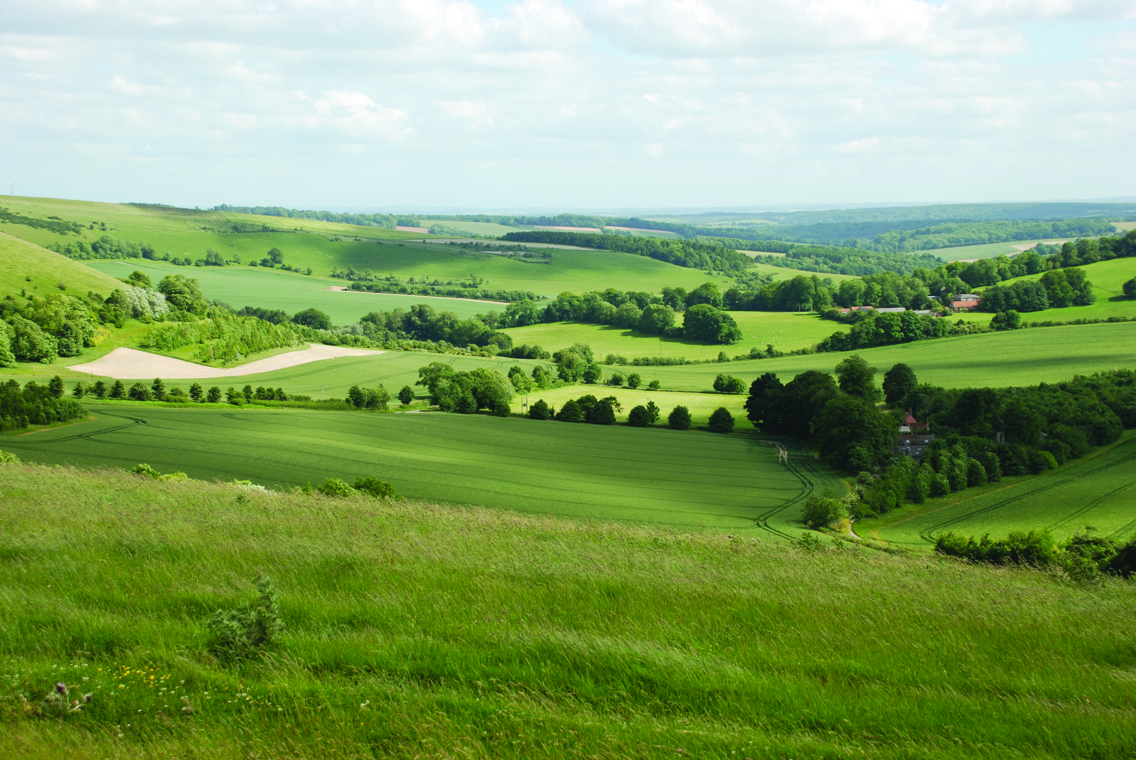

Annual Forum 2026
Quick fire session

Slide 2

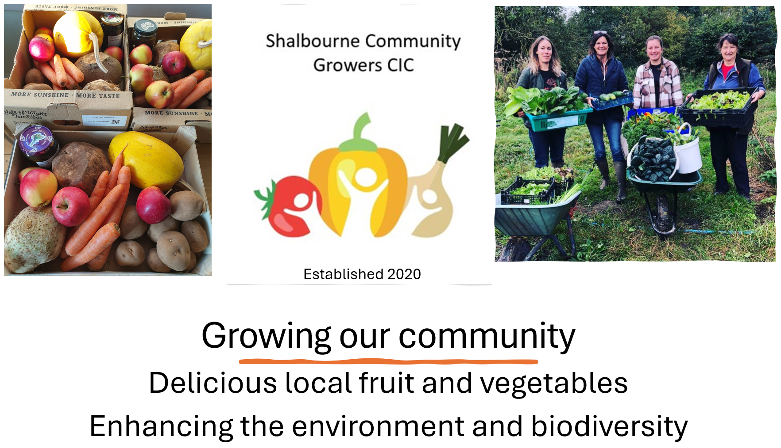



Slide 3

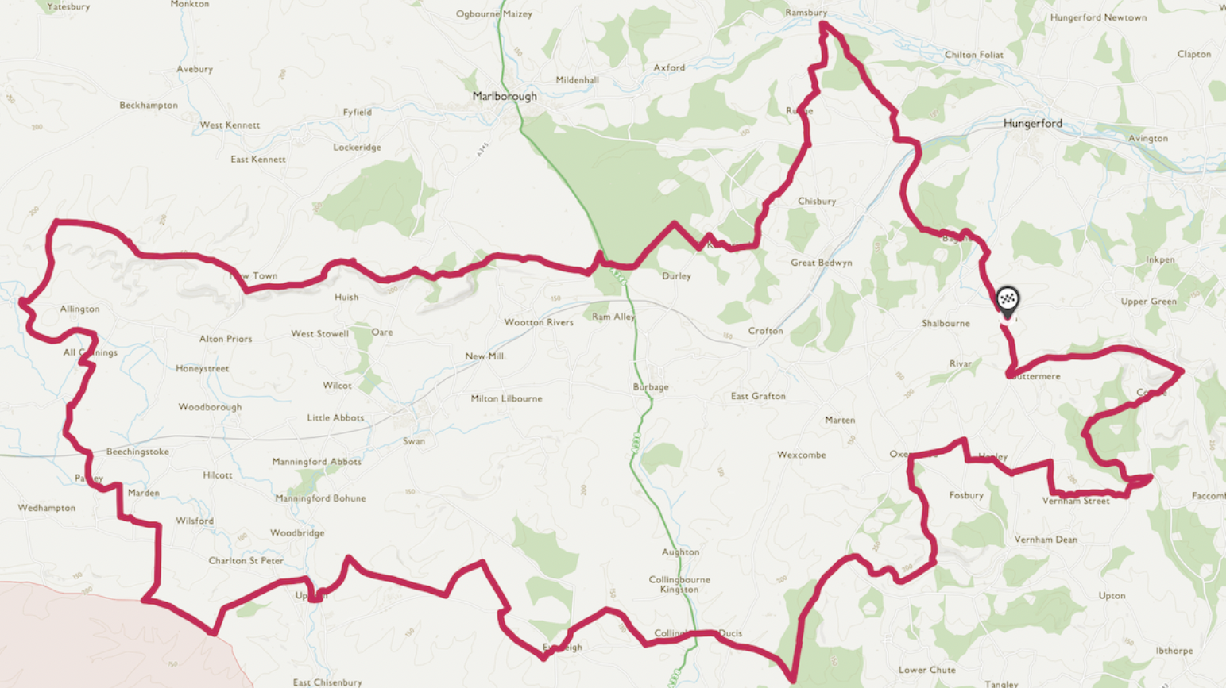
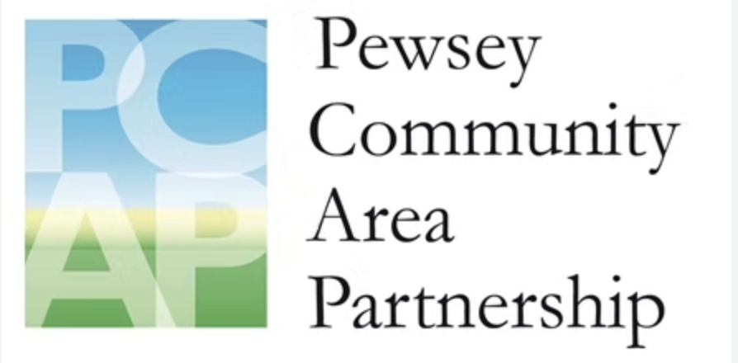

Green Vale Sylvia & Jeremy Wyatt
Building climate resilience across Pewsey Vale
Marlborough
Hungerford
Background
Community Fund lottery funding
Hosted by PCAP
Started 5 years ago with Great Green Bedwyn
Scaled from 1300 people to 18000
How
Win-win - Sharing knowledge & lessons
R&D – rob & duplicate
Finding local champions
Visits, Expert talks and Workshops
=> Connecting people with solutions
Great Bedwyn
<<Devizes
Pewsey
Burbage
Rushall
Collingbourne Ducis

Slide 4
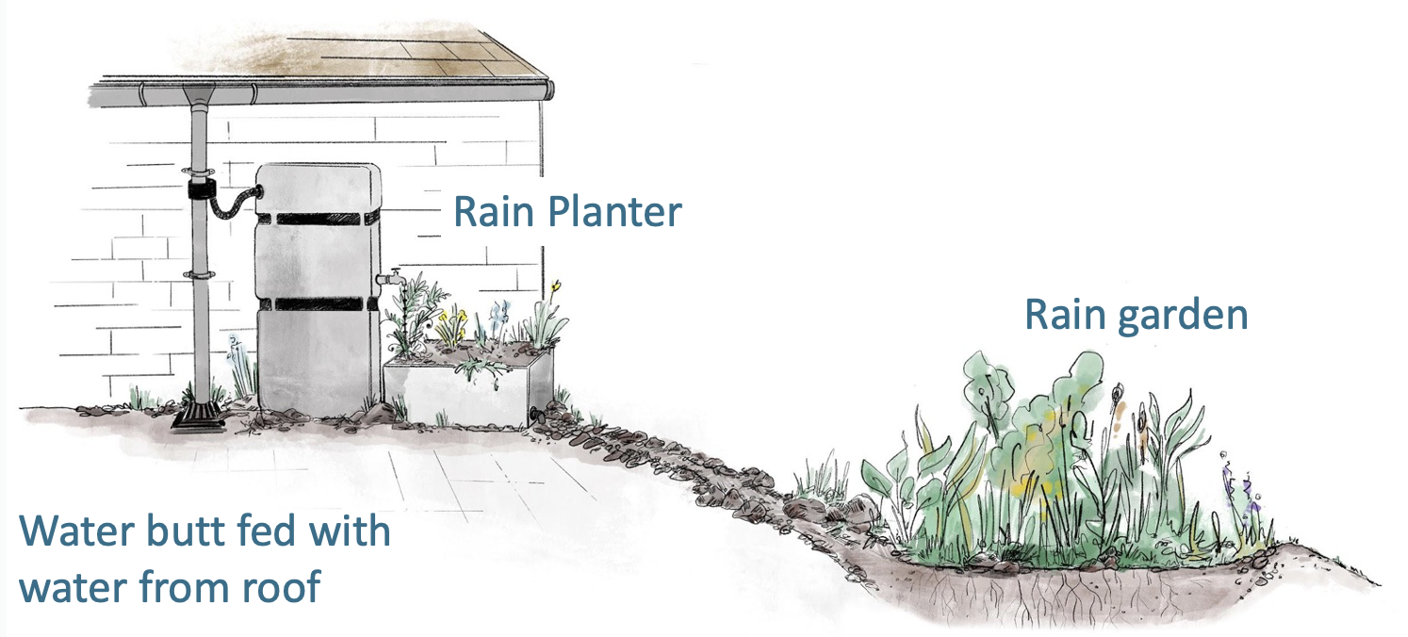
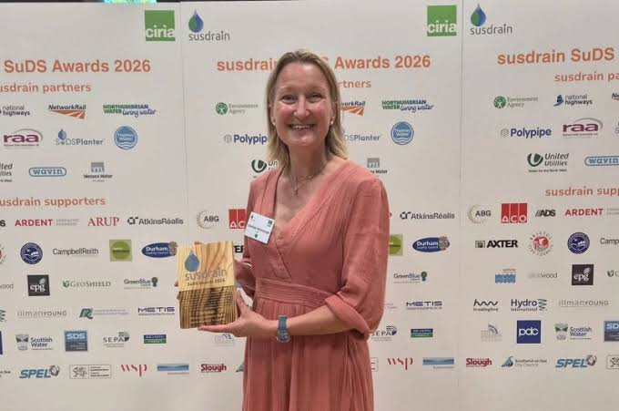
Local Problems
Community Solutions
Expensive energy bills
Lift sharing
Green Open Homes
Cold homes
Infrared surveys
Homes overheating
Funding (Warm & Safe Wilts)
Better Insulation
Air Pollution
Water quality monitoring
Farm run-off
Flood Busters
Blocked drains
Flooding leaflet
No wild swimming
Rain gardens to slow run off
Polluted water
Cover crops
Poor harvests
Tree planting
Species disappearing
Wildflower verges
iRecord nature reports
Fewer pollinators
No Mow May & June
Loss of birds
Nature-friendly gardens

Slide 5
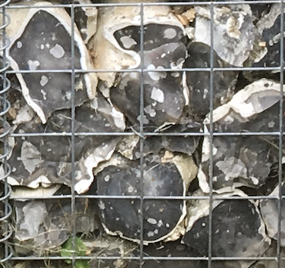
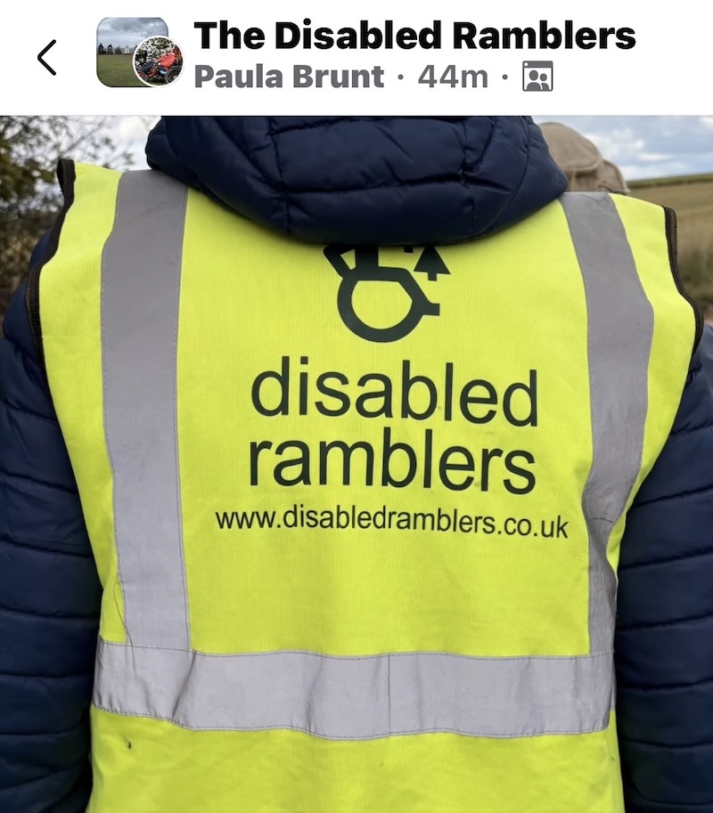
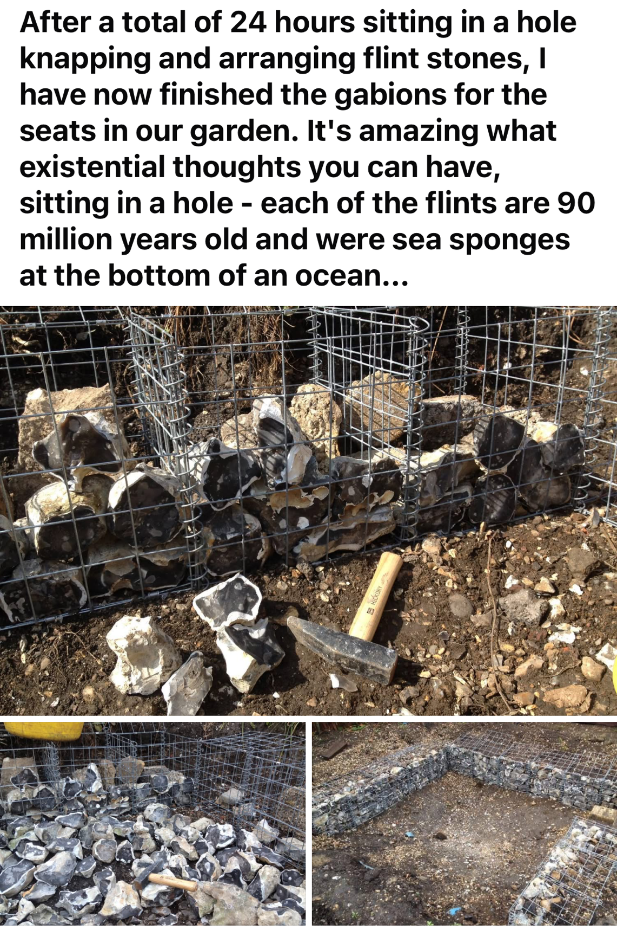
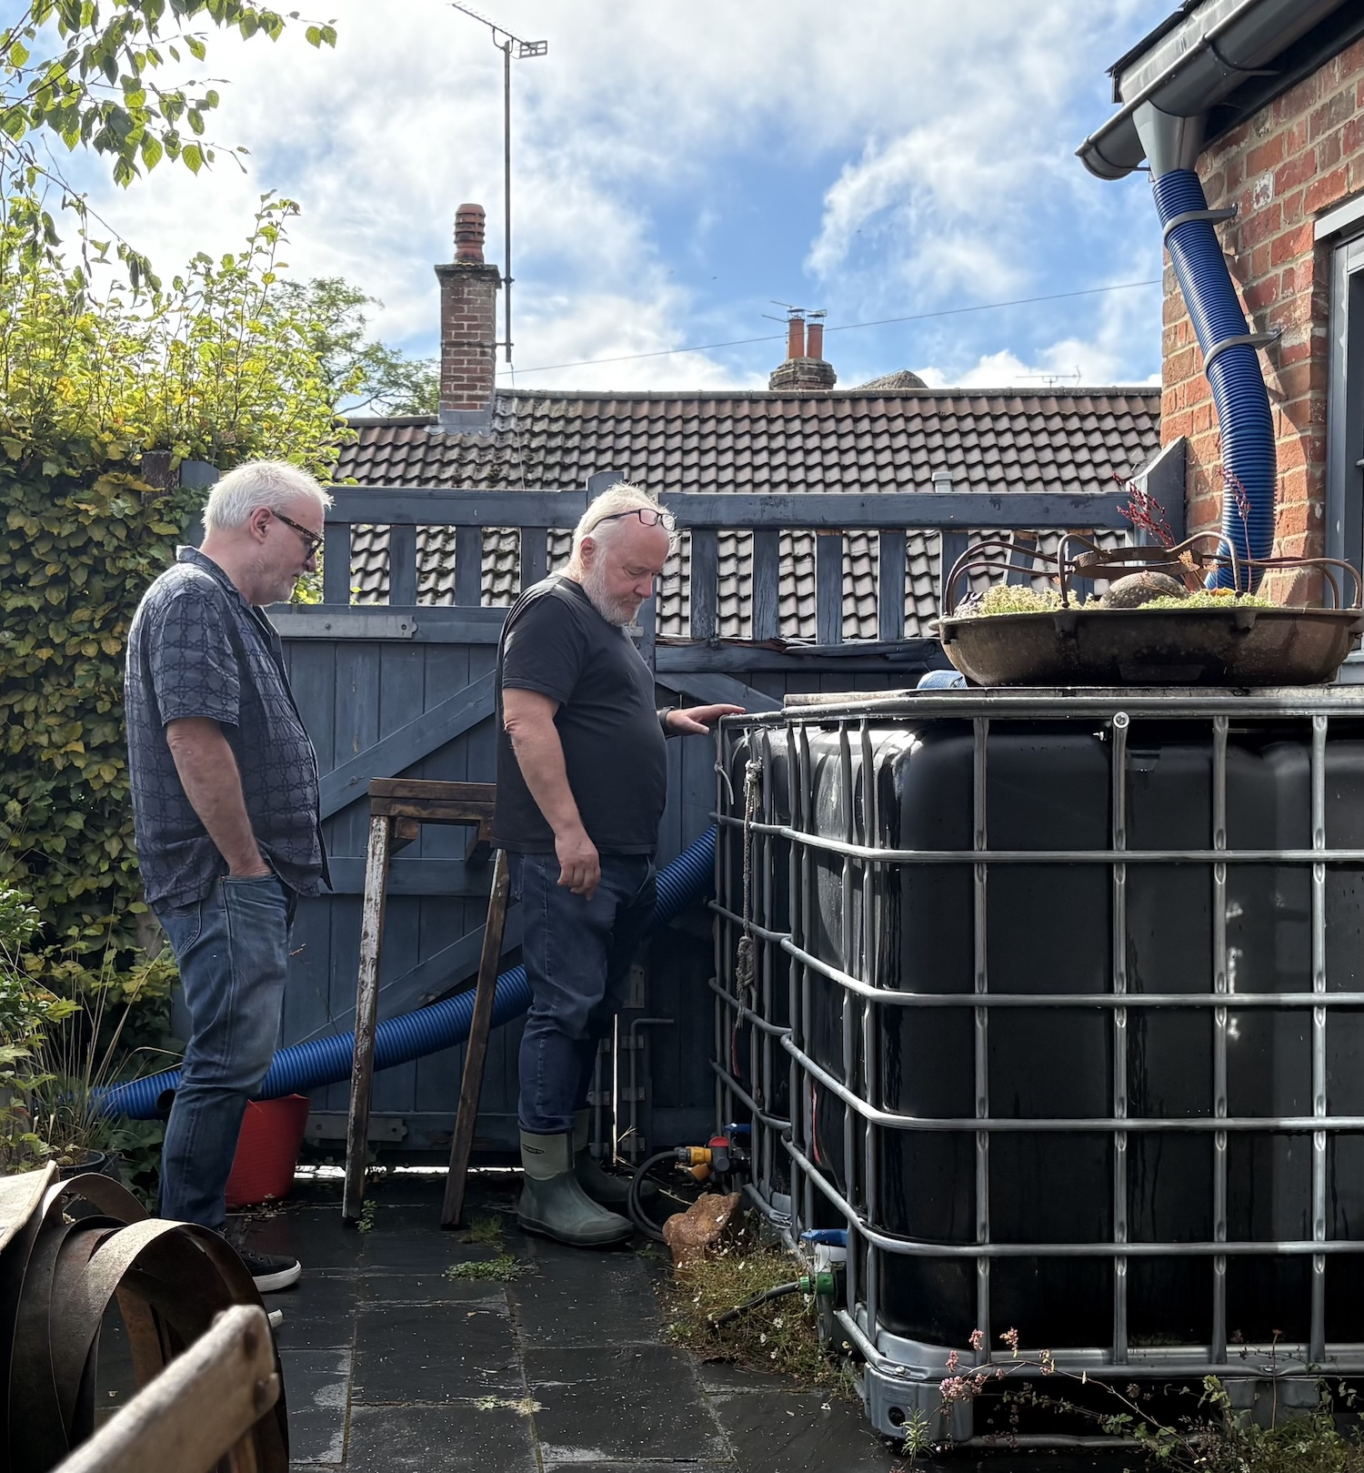
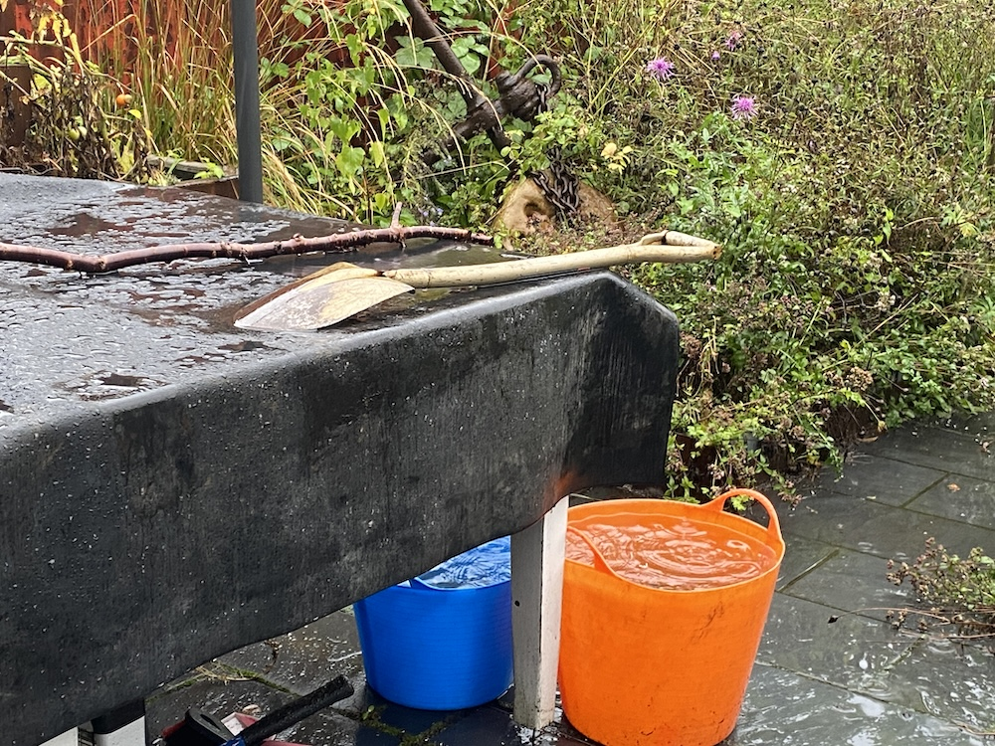
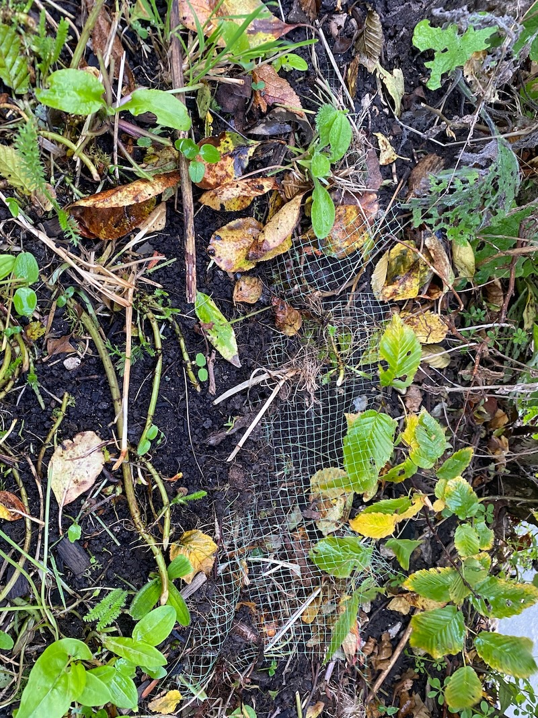
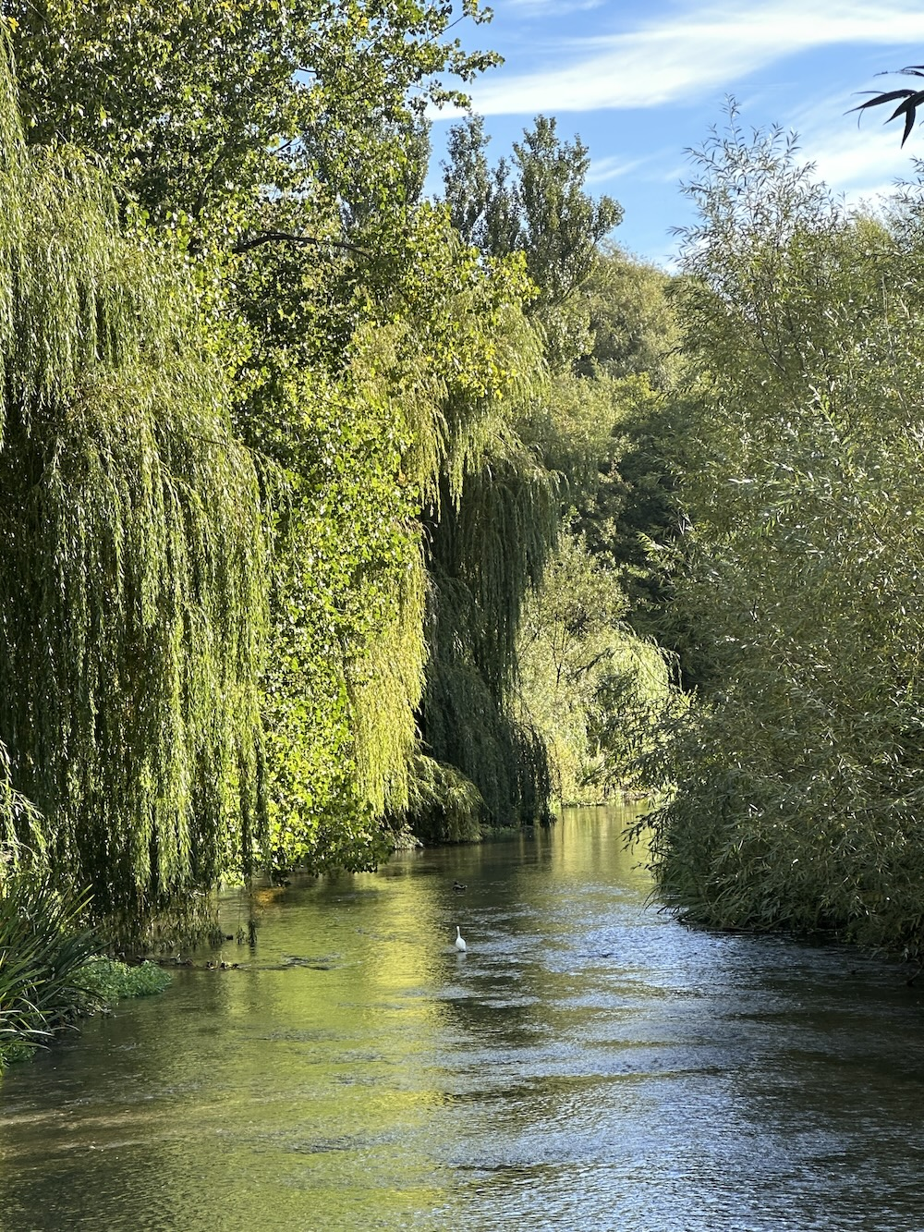
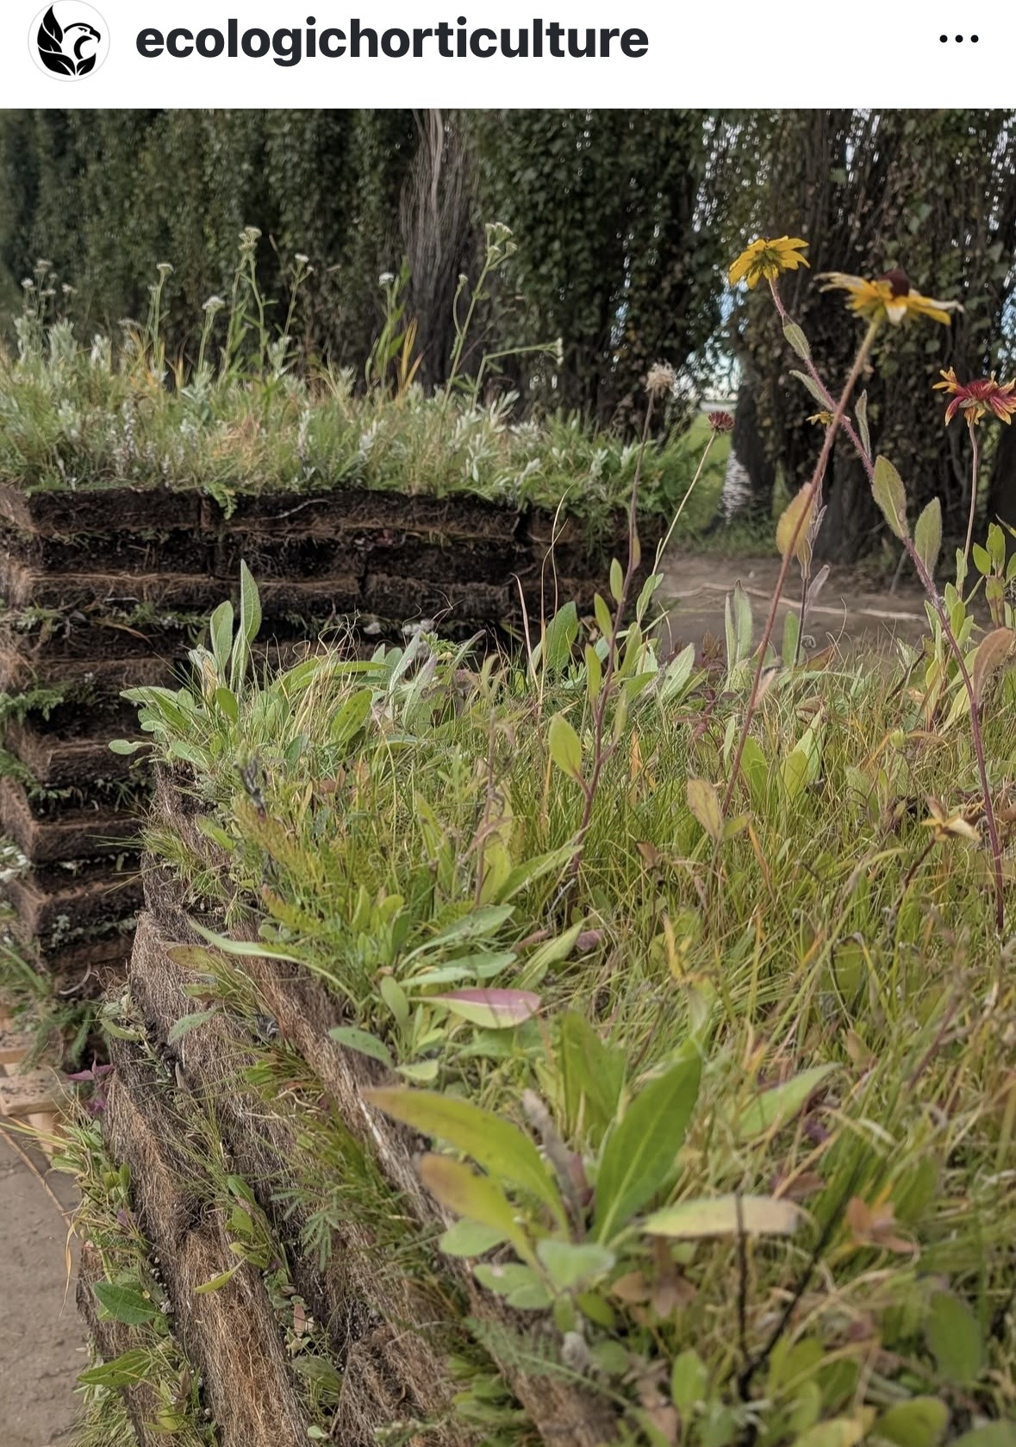
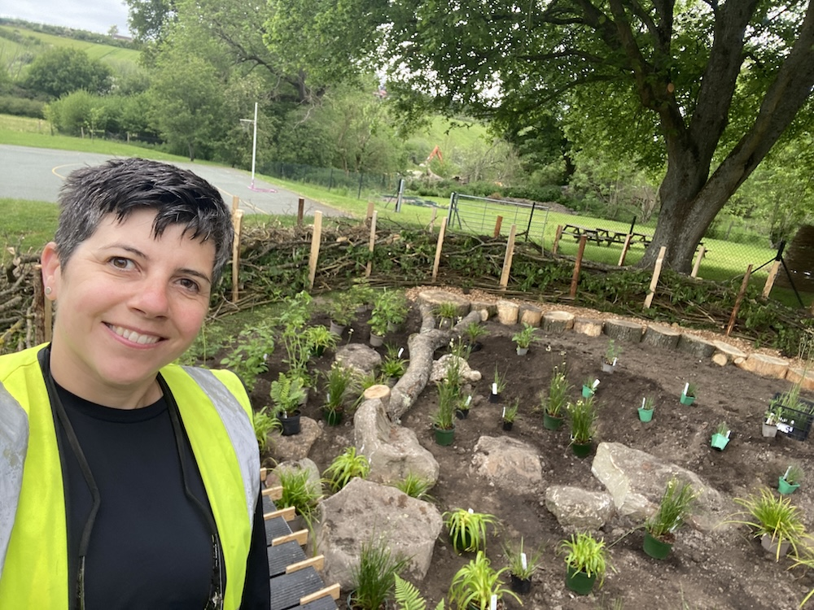
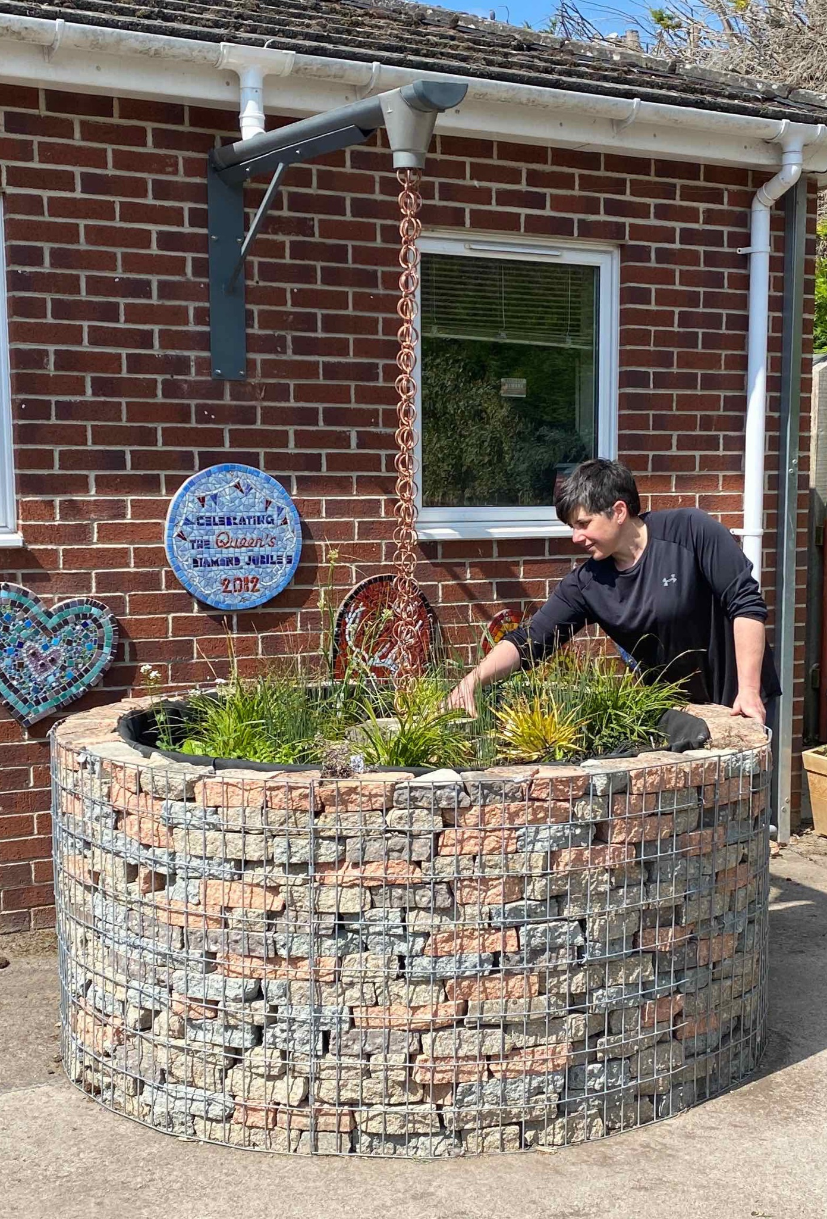
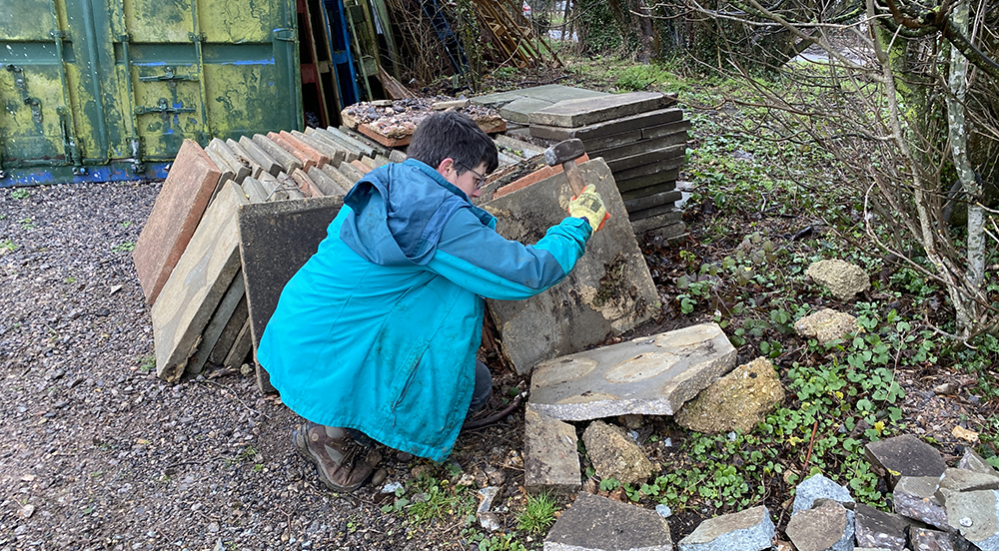
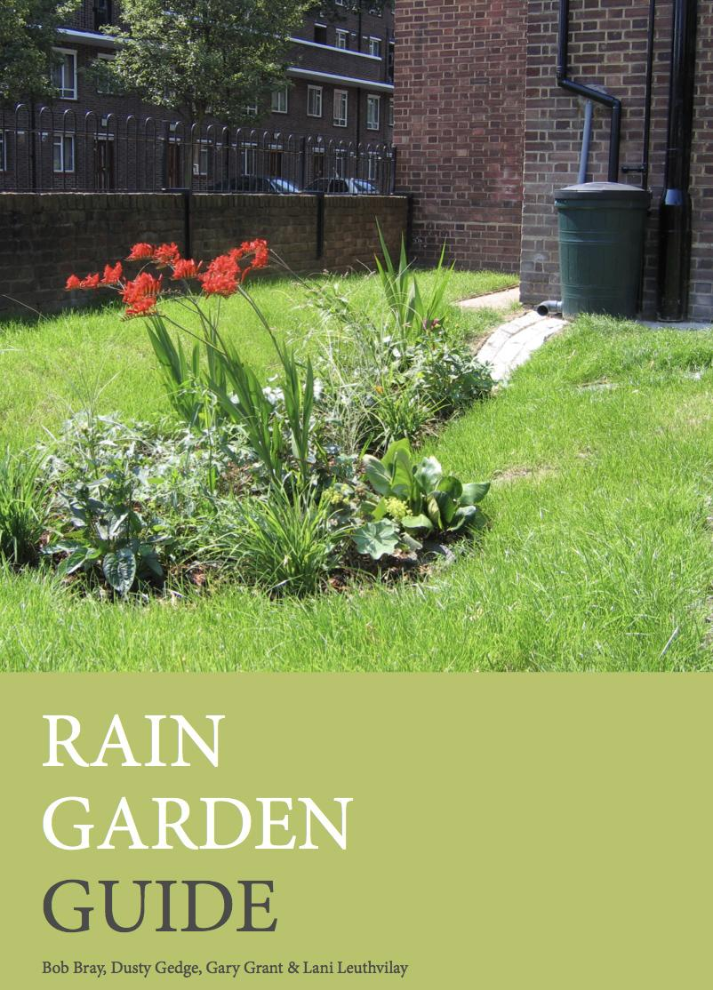
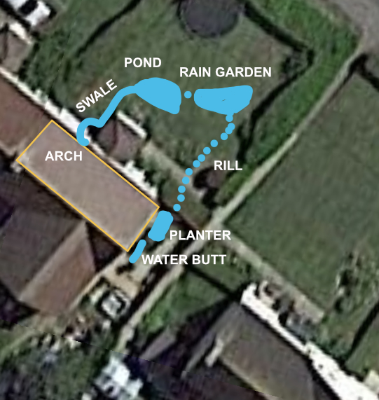
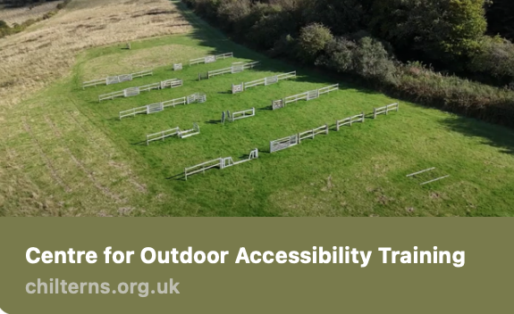
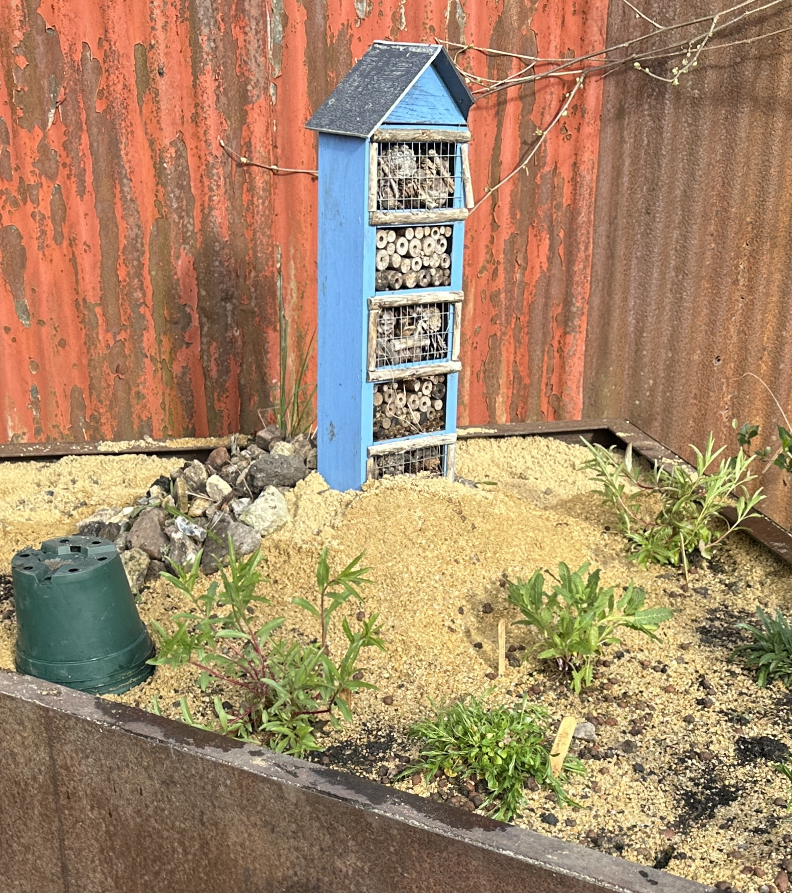
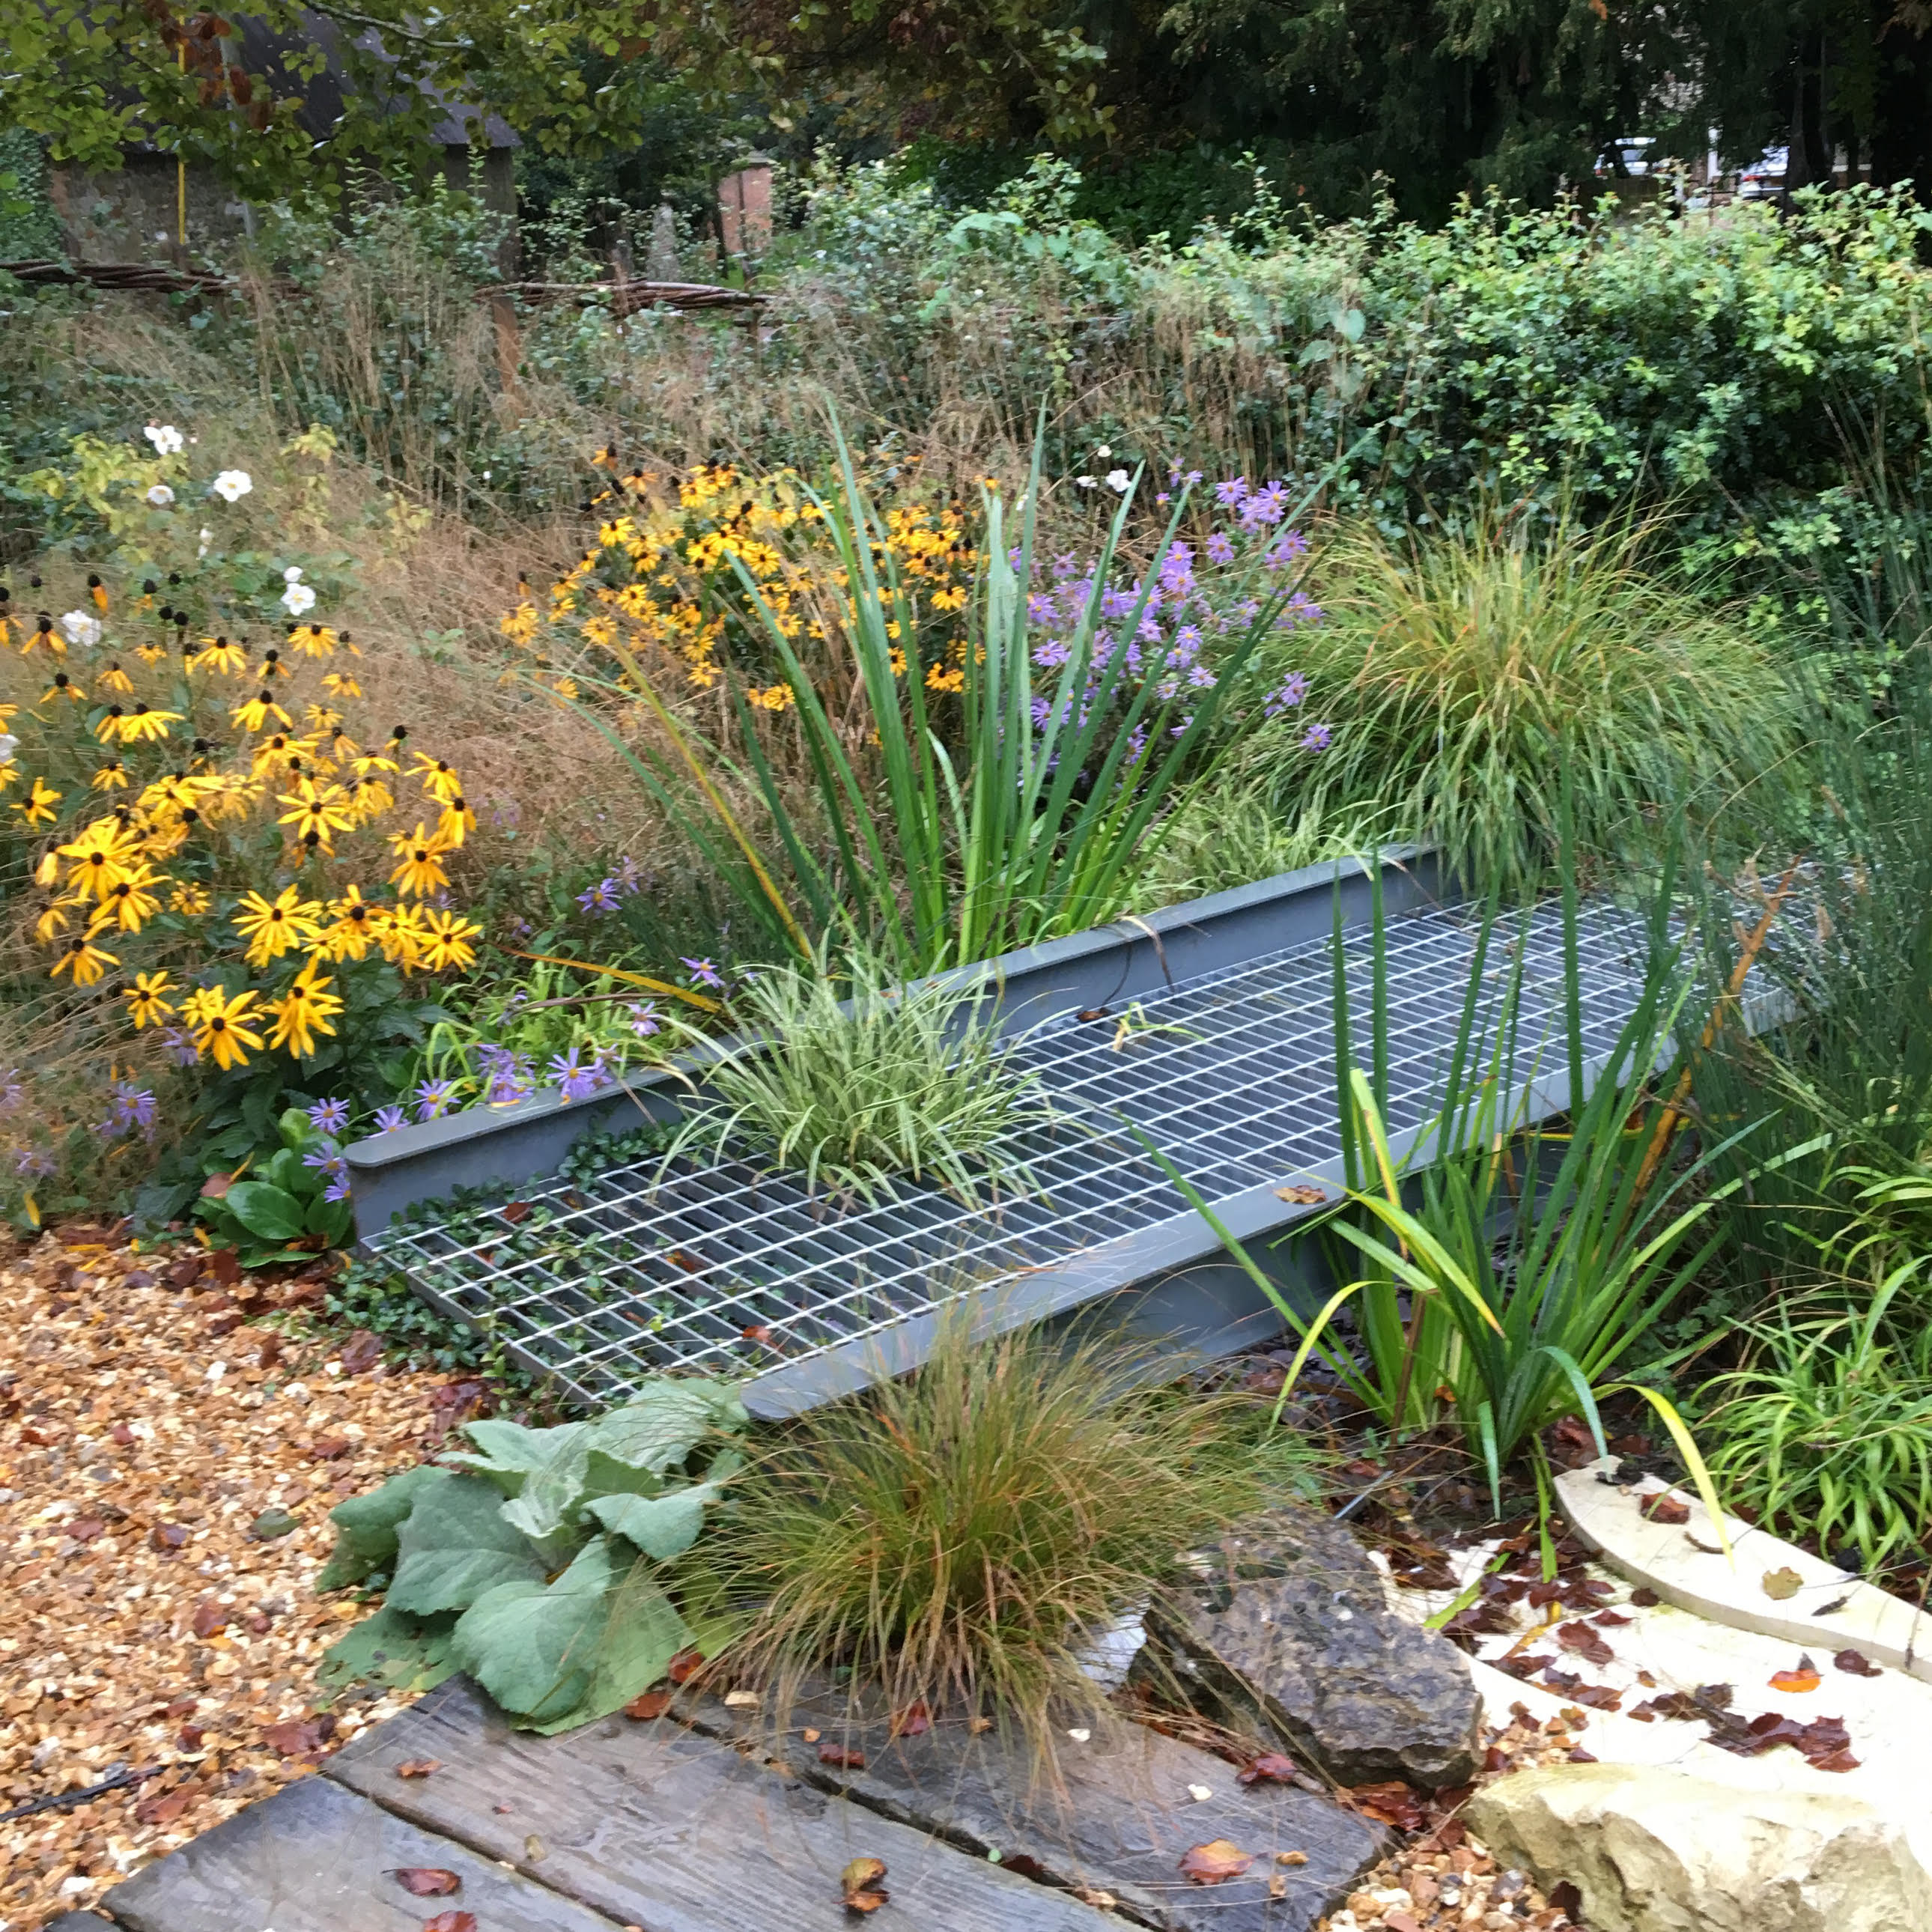
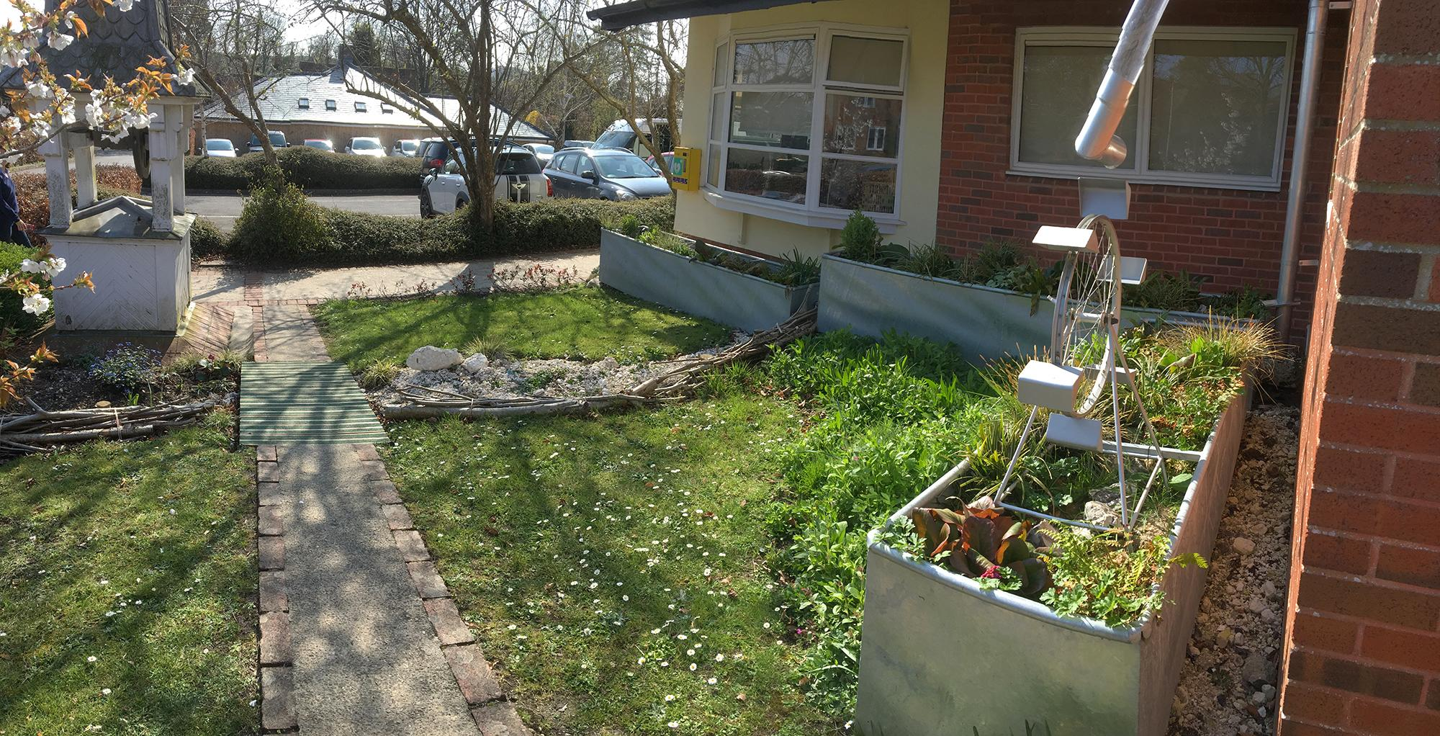
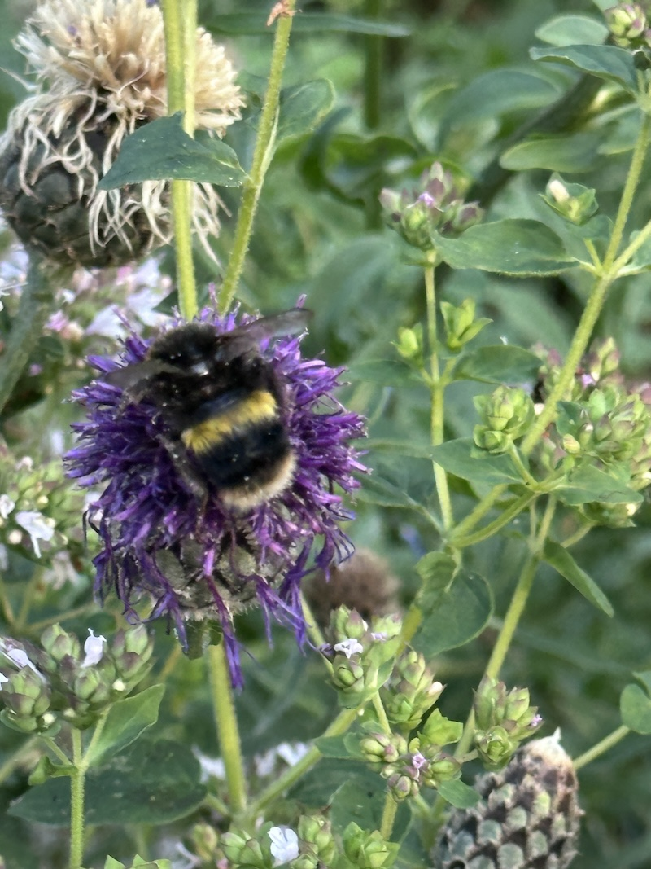
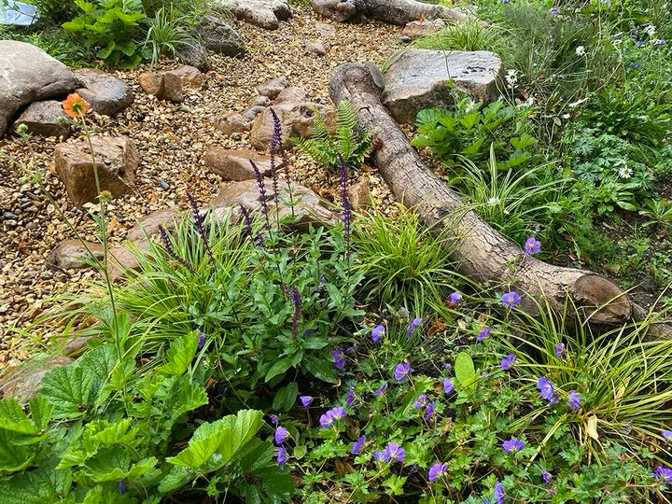
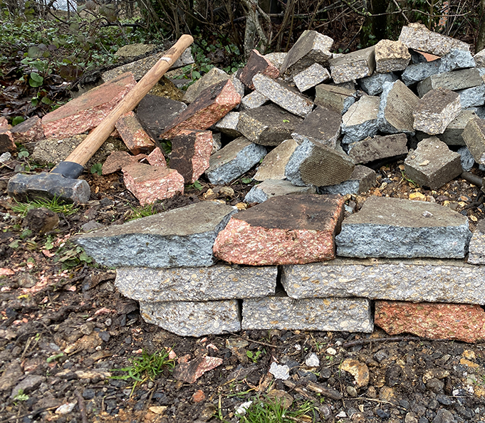
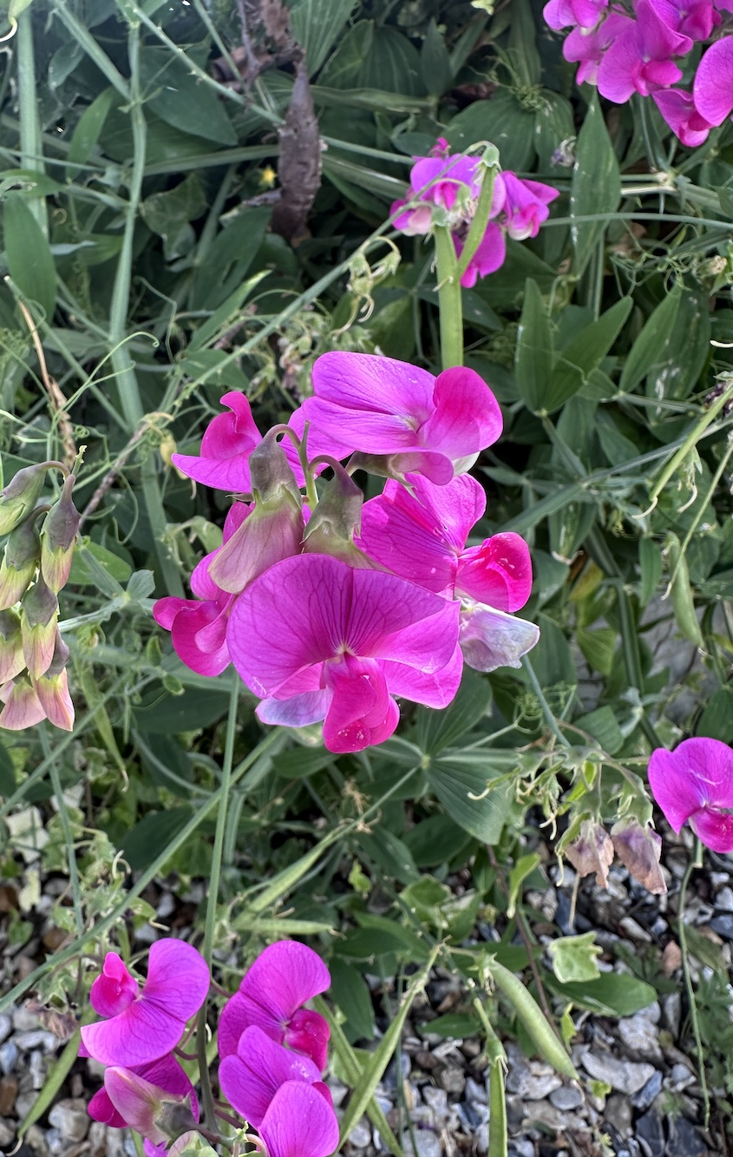
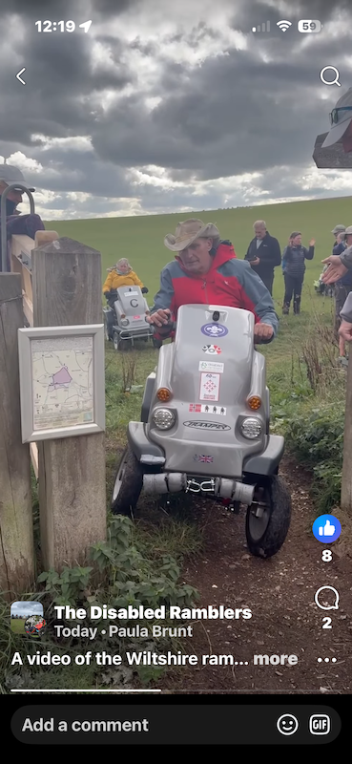
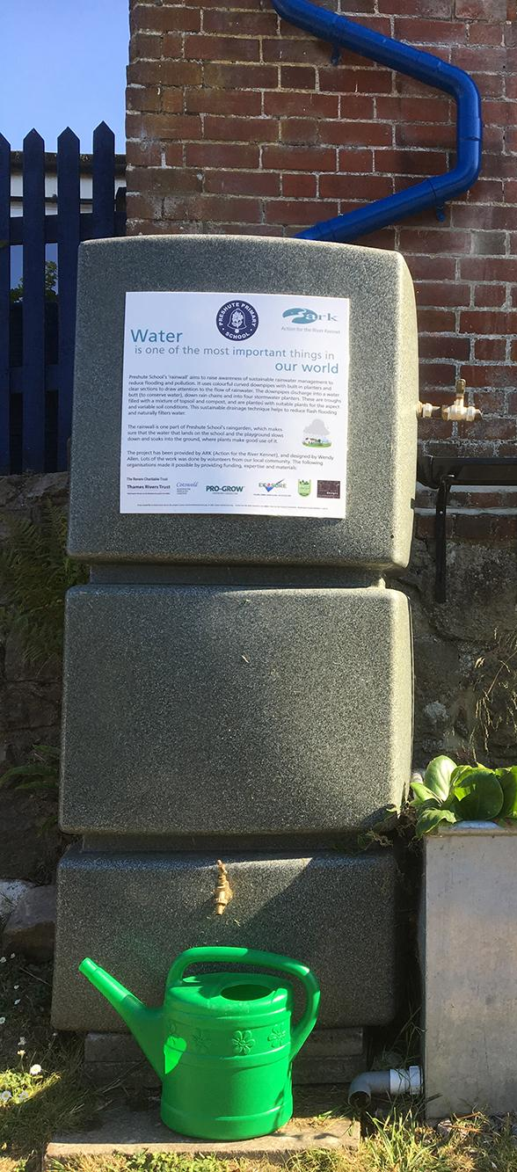
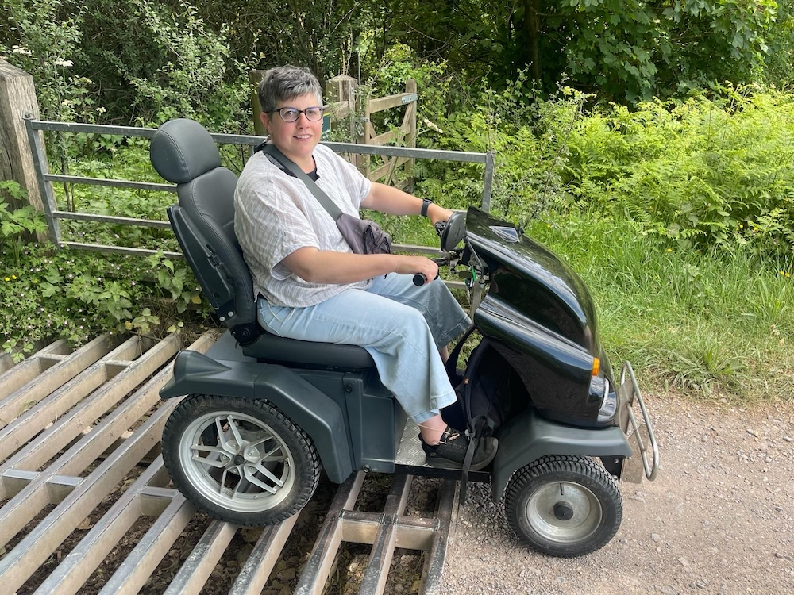
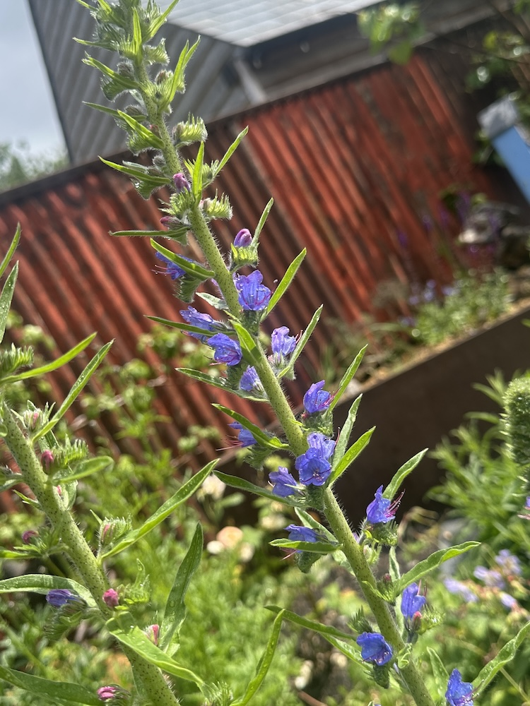
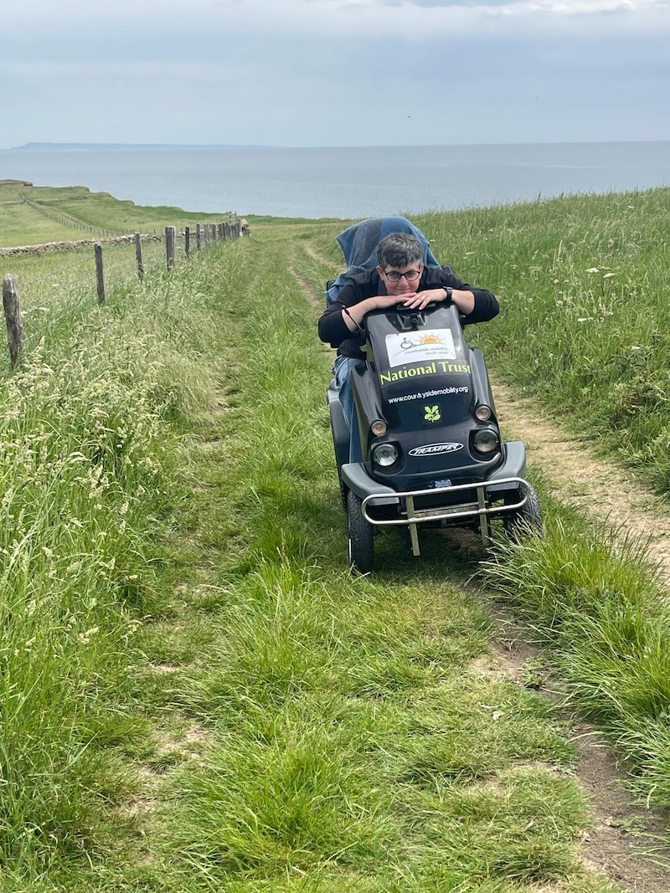
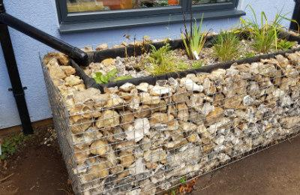
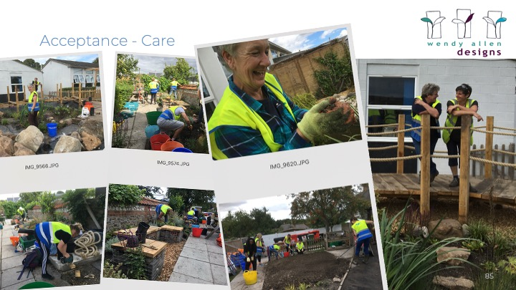
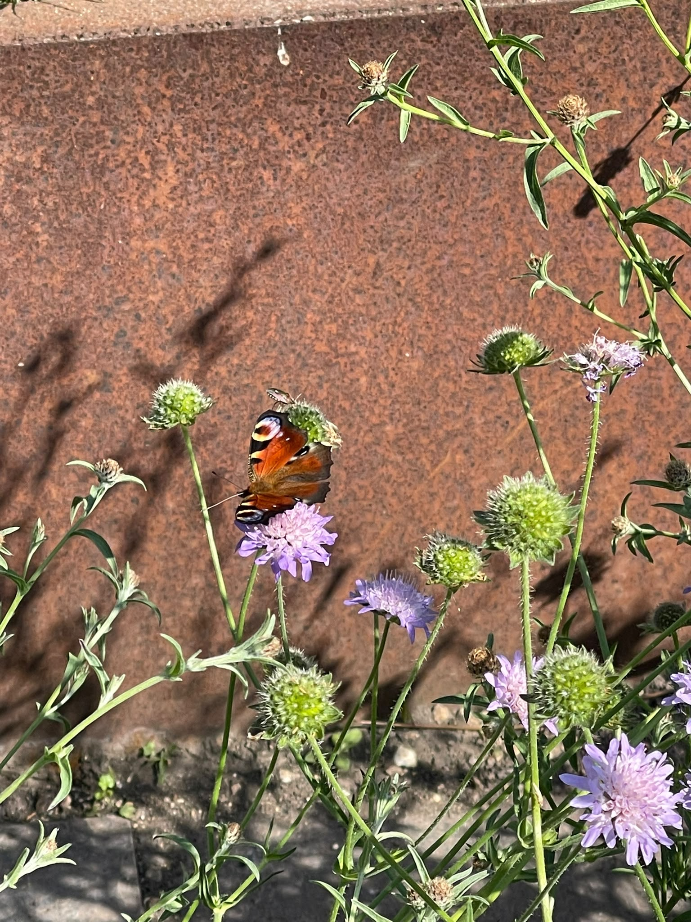
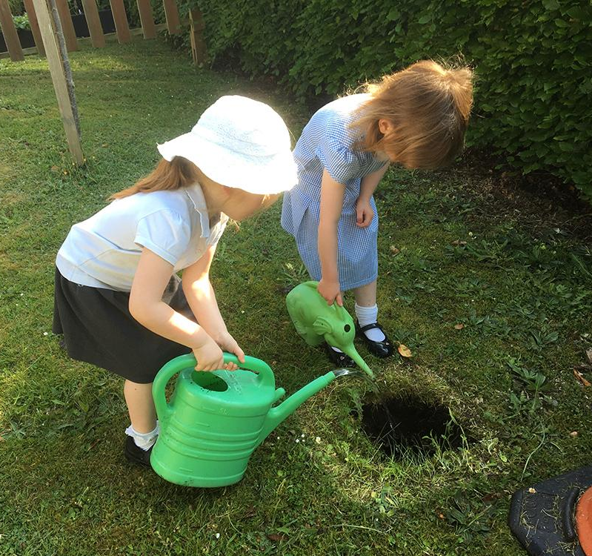
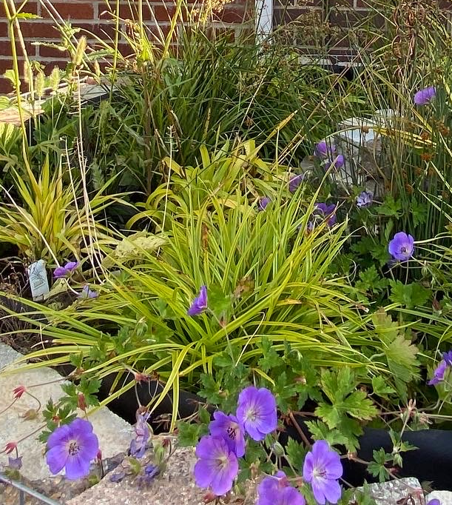
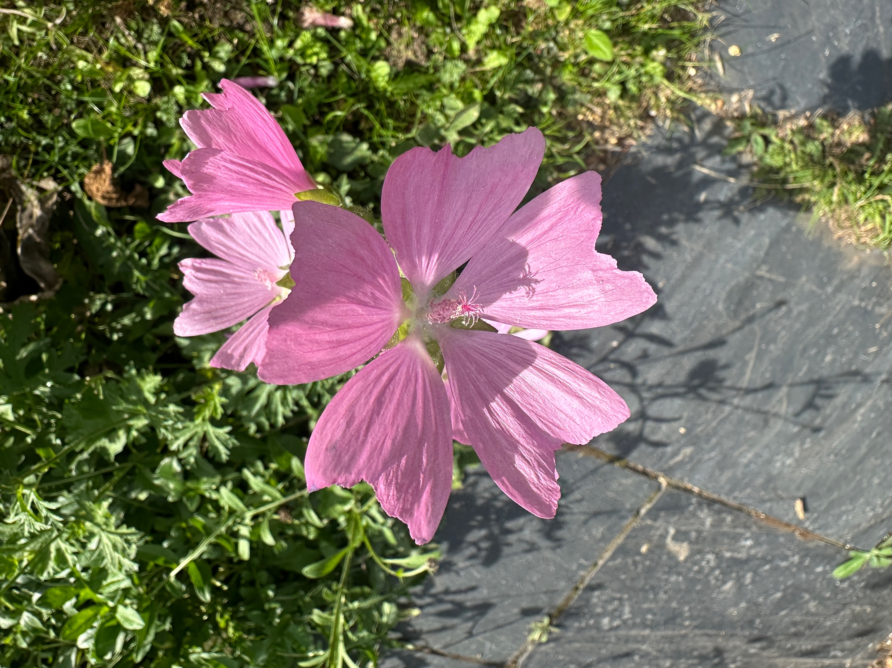
• Rain Gardens & Sustainable Drainage
Wendy Allen info@wendyallendesigns.co.uk
Wendy Allen Designs
Wendy Allen
Climate. Resilience? Accept.
Access for All – Accessibility
Retrofit SuDS – Nature, Water
Importance of Care
Do small things. Repeat.
Less Tap Water = Less Cost
Less Carbon = Less Cost
Less Paving, More Roots
Local Growers, Less Transport
Photos and Design: Wendy Allen
Wendy Allen
800 Litres
1 square metre
Perennial seeds to share
Photos and Design: Wendy Allen
Photos and Design: Wendy Allen
IBC: 1000 Litres x 2
10m² x 15mm = 150 Litres
Rain, Gravity, Surface Tension
Wendy Allen
London Rd, Marlb.
Depave - and reuse paving
© 2026 Wendy Allen

Slide 6
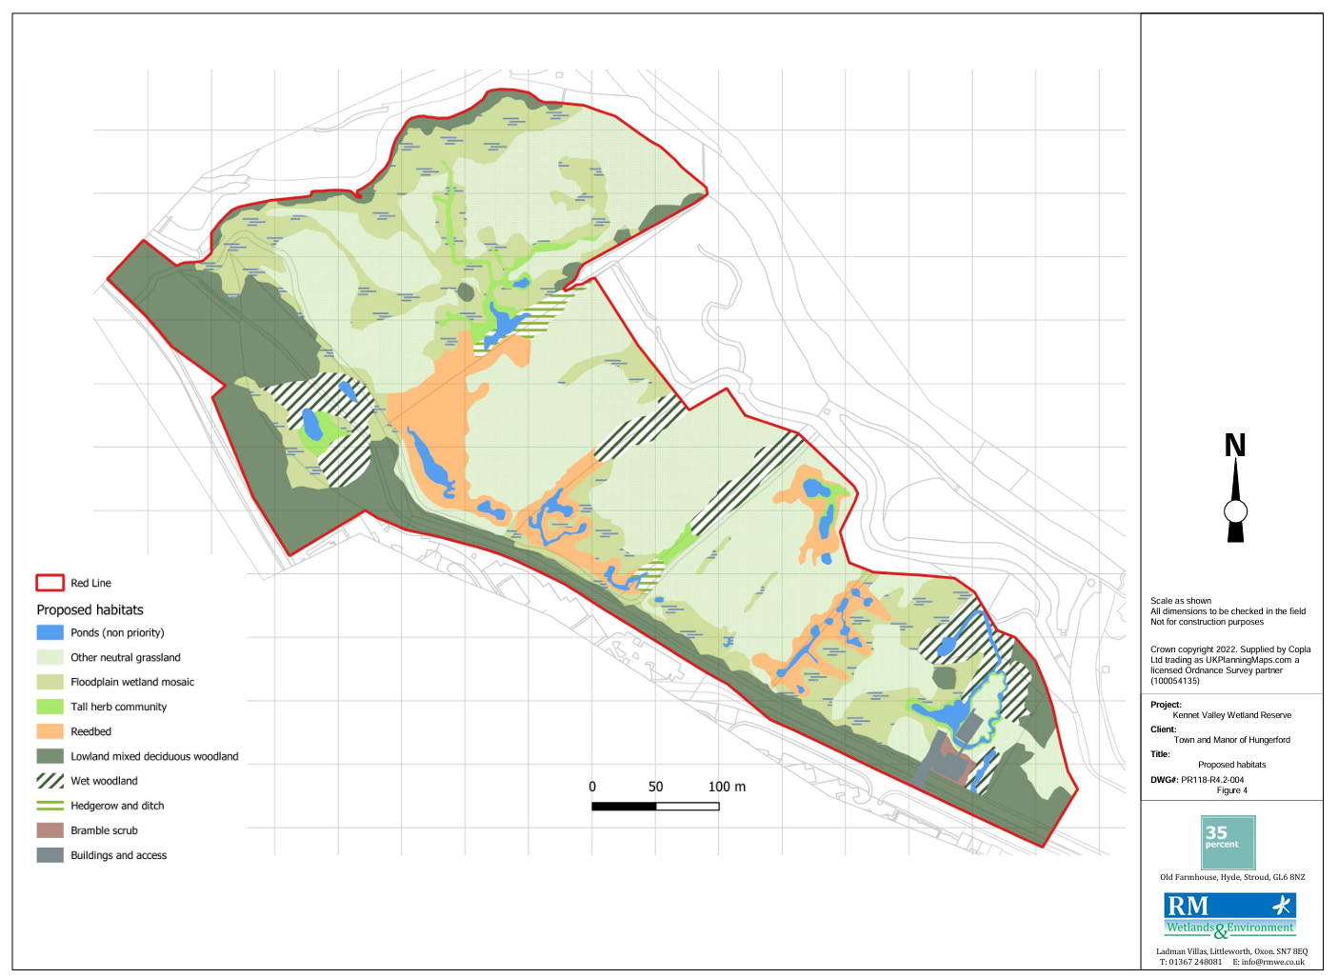
Kennet Valley Wetland Reserve project

Slide 7
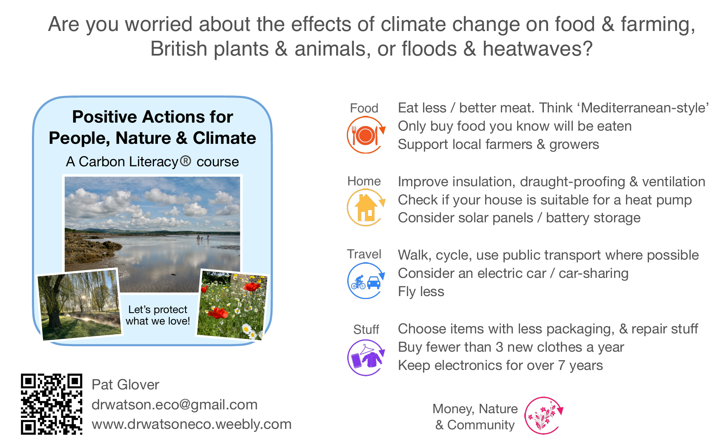

Slide 8

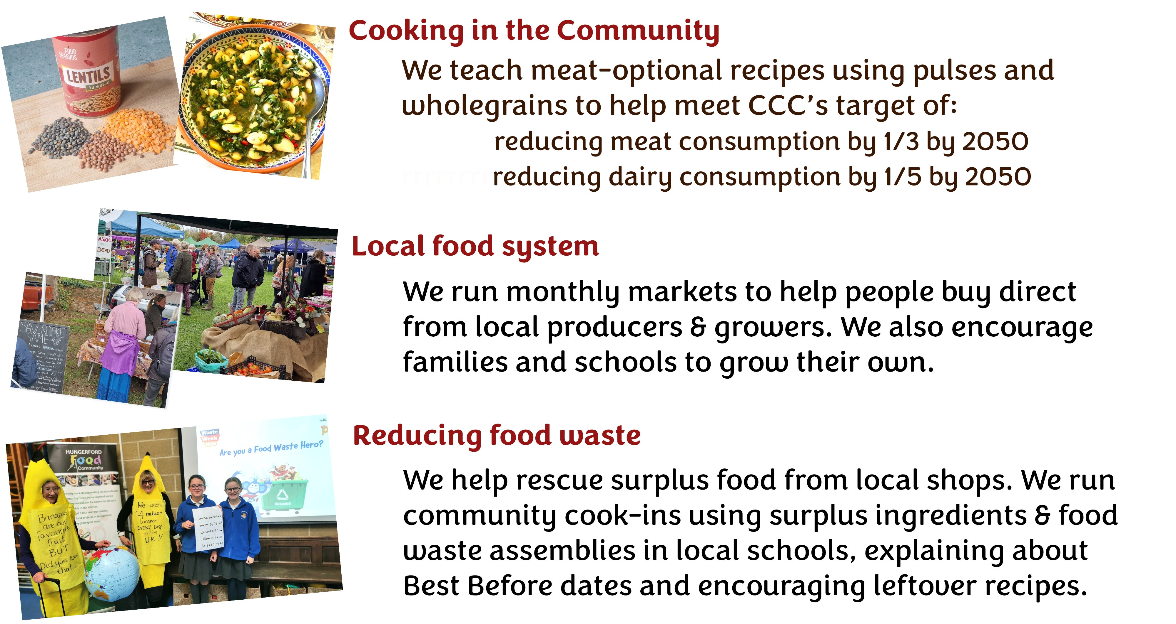
Hungerford Food Community

